Slide 1


Slide 2
Engineering Excellence – J1
Hadoop Cluster Setup
03: Review meeting : 10/06/2016
SPRINT 3 (June 06– June 17)

Slide 3
Last Week’s Action Items
All task is divided among sub teams (more than 1 person), so if anyone is not able to complete their task ,other can work to achieve the Sprint goal. Done
Team members who is not able to update the sheet should send their status along with the efforts they put and remaining hours to team, so that other members can update on their behalf. Done
Follow up with Team for sheet update every day in DSM and Review the sheet a day before Review meeting. Done
Make sure Demo PPT should be shared before weekly call describing last week action item. - Done
Retrospective meetings will be scheduled on first or second day of next sprint. - Done

Slide 4
Last Week’s Action Items
Correct the burn down chart (Sync with Sadique for correct burn down sheet) - Done
Breakdown: Nothing.

Slide 5
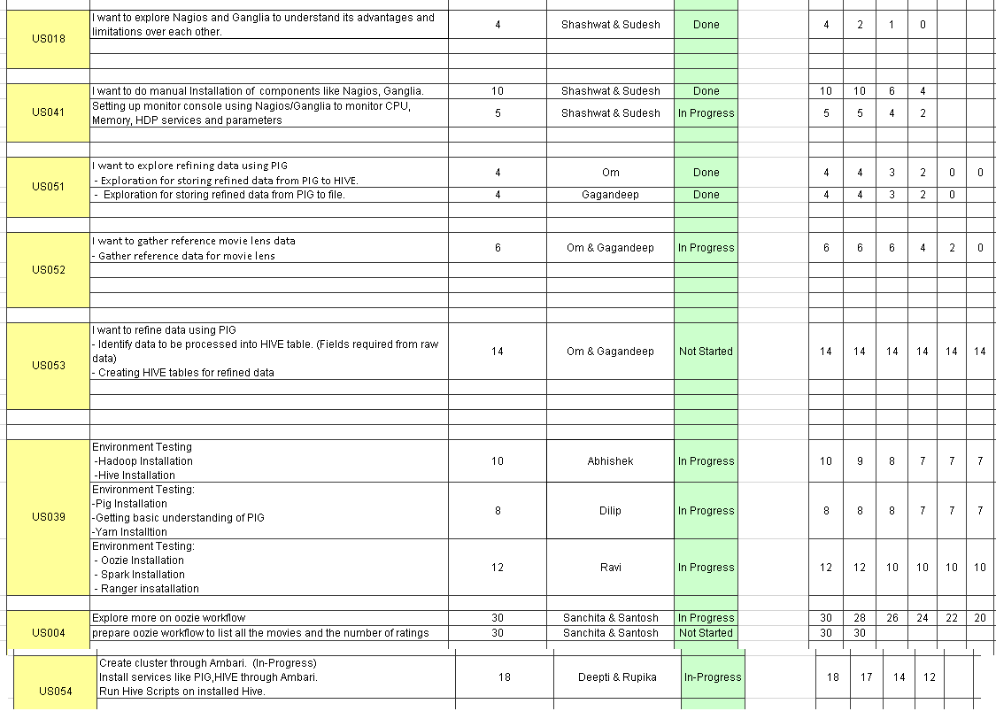
Team Status (Sprint 3)

Slide 6
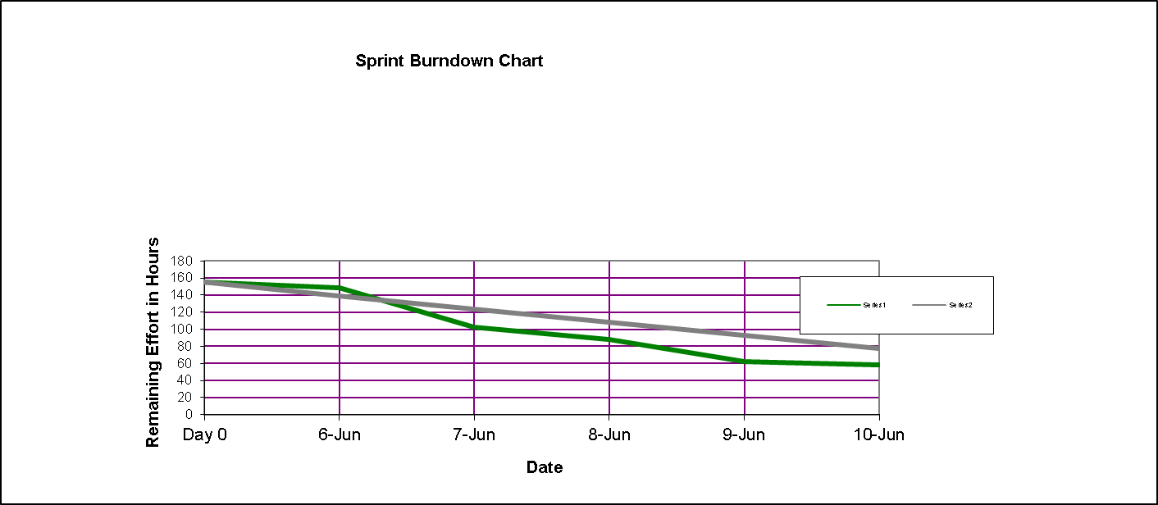
Burn down chart on – 06/10/2016

Slide 7
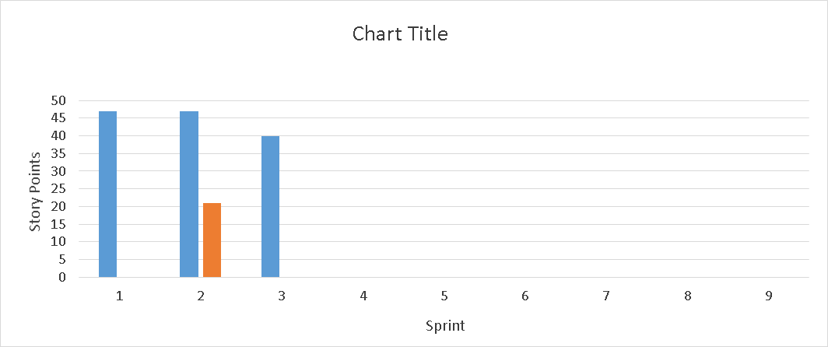
Velocity Trend on– 06/10/2016

Slide 8
Thanks

